Slide 1
Screenshots(More challenges section)
Prepared By:
Ishraq AlDagamseh

Slide 2
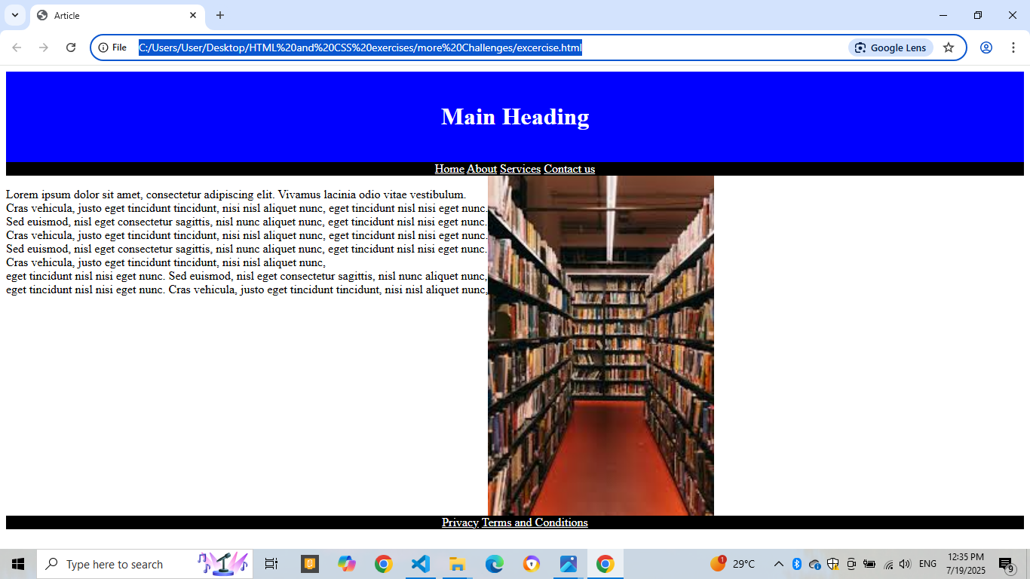
Webpage screenshot (more challenges)

